Slide 1
Chapter Seven
Local Area Networks: Part 1
Data Communications and Computer Networks: A Business User’s Approach
Eighth Edition

Slide 2
After reading this chapter, you should be able to:
State the definition of a local area network
List the primary function, activities, and application areas of a local area network
Cite the advantages and disadvantages of local area networks
Identify the physical and logical layouts (topologies) of local area networks
Data Communications and Computer Networks: A Business User's Approach, Eighth Edition
© 2016. Cengage Learning. All Rights Reserved.

Slide 3
After reading this chapter, you should be able to (continued):
Specify the different medium access control techniques
Recognize the different IEEE 802 frame formats
Describe the common local area network systems
Data Communications and Computer Networks: A Business User's Approach, Eighth Edition
© 2016. Cengage Learning. All Rights Reserved.

Slide 4
Introduction
A local area network is a communication network that interconnects a variety of data communicating devices within a small geographic area and broadcasts data at high data transfer rates
Since the local area network first appeared in the 1970s, its use has become widespread in commercial and academic environments
Data Communications and Computer Networks: A Business User's Approach, Eighth Edition
© 2016. Cengage Learning. All Rights Reserved.

Slide 5
Primary Function of Local Area Networks
To provide access to hardware and software resources that will allow users to perform one or more of the following activities:
  Access to the Internet
  File serving
    A large storage disk drive acts as a central storage repository
  Print serving
    Providing the authorization to access a particular printer, accept and queue print jobs, and providing a user access to the print queue to perform administrative duties
  Database and application serving
Data Communications and Computer Networks: A Business User's Approach, Eighth Edition
© 2016. Cengage Learning. All Rights Reserved.

Slide 6
Primary Function of Local Area Networks (continued)
To provide access to hardware and software resources that will allow users to perform one or more of the following activities (continued):
  Manufacturing support
    LANs can support manufacturing and industrial environments
  Academic support
    In classrooms, labs, and wireless
  E-mail serving
  Interconnection between multiple systems
Data Communications and Computer Networks: A Business User's Approach, Eighth Edition
© 2016. Cengage Learning. All Rights Reserved.

Slide 7
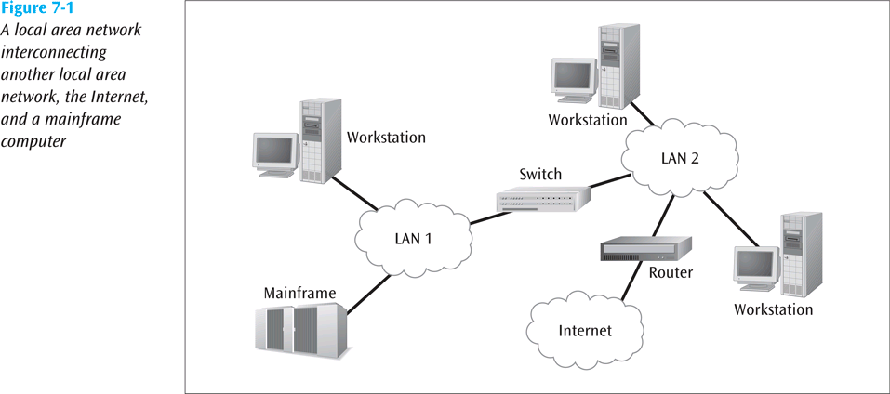
Primary Function of Local Area Networks (continued)
Data Communications and Computer Networks: A Business User's Approach, Eighth Edition
© 2016. Cengage Learning. All Rights Reserved.

Slide 8
Advantages and Disadvantages of
Local Area Networks
Advantages
  Ability to share hardware and software resources
  Individual workstation might survive network failure
  Component and system evolution are possible
  Support for heterogeneous forms of hardware and software
  Access to other LANs and WANs (Figure 7-1)
  Private ownership (maybe a disadvantage)
  Secure transfers at high speeds with low error rates
Data Communications and Computer Networks: A Business User's Approach, Eighth Edition
© 2016. Cengage Learning. All Rights Reserved.

Slide 9
Advantages and Disadvantages of
Local Area Networks (continued)
Disadvantages
  Equipment and support can be costly
  Level of maintenance continues to grow
  Private ownership (lease option attractive for some)
  Some types of hardware may not interoperate
  Just because a LAN can support two different kinds of packages does not mean their data can interchange easily
  LAN is only as strong as its weakest link, and there are many links
Data Communications and Computer Networks: A Business User's Approach, Eighth Edition
© 2016. Cengage Learning. All Rights Reserved.

Slide 10
The First Local Area Network –
The Bus/Tree
The original topology
Workstation has a network interface card (NIC) that attaches to the bus (a coaxial cable) via a tap
Data can be transferred using either baseband digital signals or broadband analog signals
Data Communications and Computer Networks: A Business User's Approach, Eighth Edition
© 2016. Cengage Learning. All Rights Reserved.

Slide 11
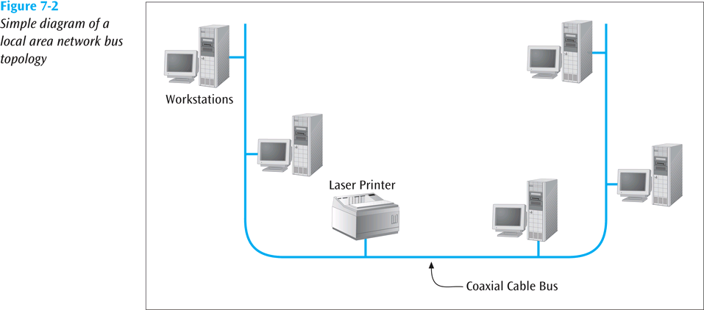
Bus/Tree (continued)
Data Communications and Computer Networks: A Business User's Approach, Eighth Edition
© 2016. Cengage Learning. All Rights Reserved.

Slide 12
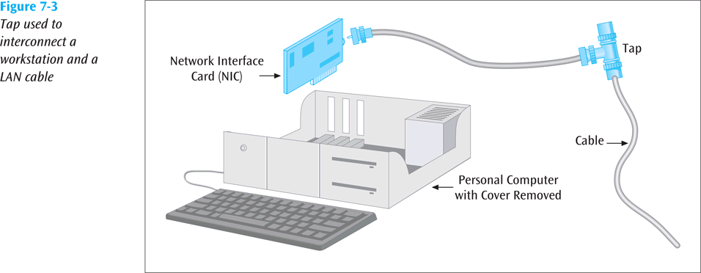
Bus/Tree (continued)
Data Communications and Computer Networks: A Business User's Approach, Eighth Edition
© 2016. Cengage Learning. All Rights Reserved.

Slide 13
Bus/Tree (continued)
Baseband signals are bidirectional and more outward in both directions from the workstation transmitting
Broadband signals are usually uni-directional and transmit in only one direction
  Because of this, special wiring considerations are necessary
Buses can be split and joined, creating trees
Data Communications and Computer Networks: A Business User's Approach, Eighth Edition
© 2016. Cengage Learning. All Rights Reserved.

Slide 14
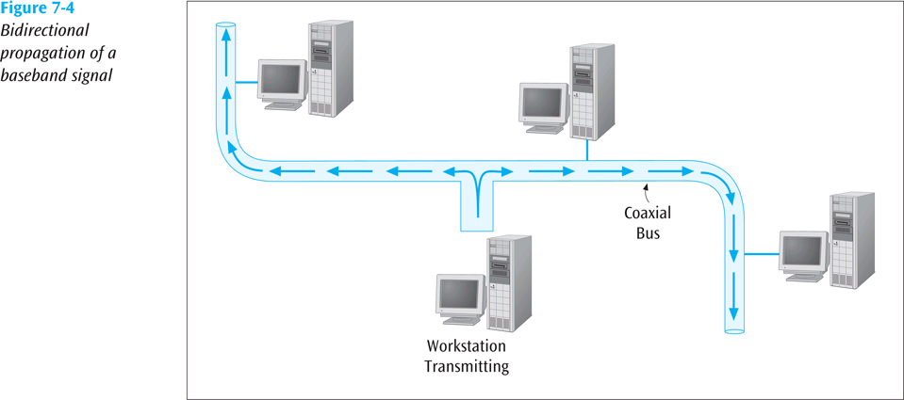
Bus/Tree (continued)
Data Communications and Computer Networks: A Business User's Approach, Eighth Edition
© 2016. Cengage Learning. All Rights Reserved.

Slide 15
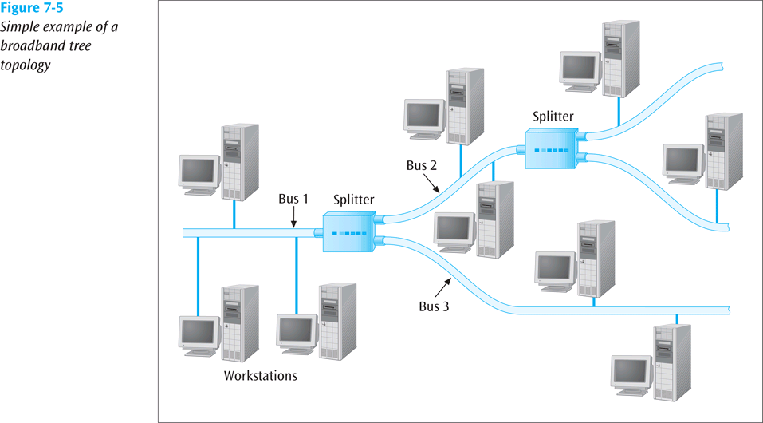
Bus/Tree (continued)
Data Communications and Computer Networks: A Business User's Approach, Eighth Edition
© 2016. Cengage Learning. All Rights Reserved.

Slide 16
A More Modern LAN –
The Star-Wired Bus
Logically operates as a bus, but physically looks like a star
Star design is based on hub
  All workstations attach to hub
Unshielded twisted pair usually used to connect workstation to hub
Originally, hub takes incoming signal and immediately broadcasts it out all connected links
Hubs can be interconnected to extend size of network
Data Communications and Computer Networks: A Business User's Approach, Eighth Edition
© 2016. Cengage Learning. All Rights Reserved.

Slide 17
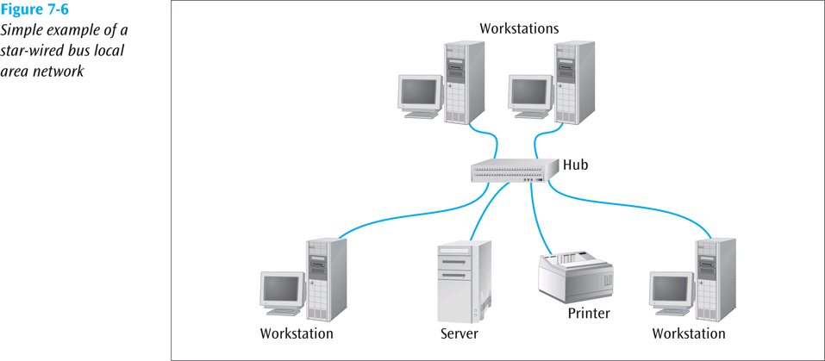
Star-Wired Bus (continued)
Data Communications and Computer Networks: A Business User's Approach, Eighth Edition
© 2016. Cengage Learning. All Rights Reserved.

Slide 18
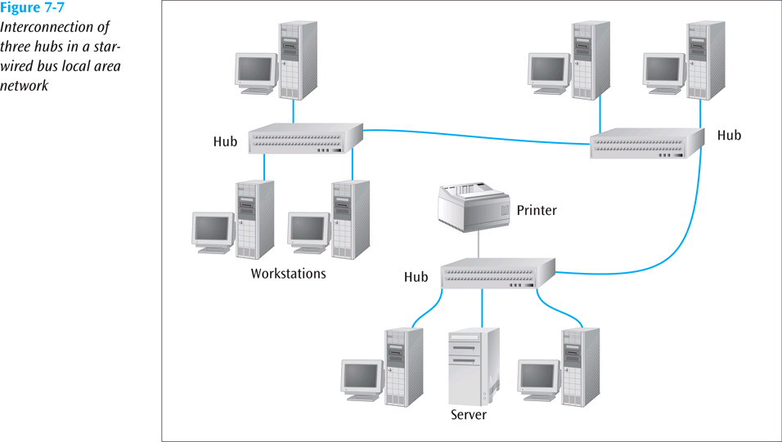
Star-Wired Bus (continued)
Data Communications and Computer Networks: A Business User's Approach, Eighth Edition
© 2016. Cengage Learning. All Rights Reserved.

Slide 19
Star-Wired Bus (continued)
Modular connectors and twisted pair make installation and maintenance of star-wired bus better than standard bus
Hubs can be interconnected with twisted pair, coaxial cable, or fiber-optic cable
Biggest disadvantage: when one station talks, everyone hears it
  This is called a shared network
    All devices are sharing the network medium
Data Communications and Computer Networks: A Business User's Approach, Eighth Edition
© 2016. Cengage Learning. All Rights Reserved.

Slide 20
Medium Access Control Protocols
How does a workstation get its data onto the LAN medium?
A medium access control protocol is the software that allows workstations to “take turns” at transmitting data
Two basic categories:
  Contention-based protocols
  Round-robin protocols
Data Communications and Computer Networks: A Business User's Approach, Eighth Edition
© 2016. Cengage Learning. All Rights Reserved.

Slide 21
Contention-Based Protocols
Essentially first-come, first-served
Most common example is carrier sense multiple access with collision detection (CSMA/CD)
If no one is transmitting, workstation can transmit
If someone else is transmitting, workstation “backs off” and waits
Data Communications and Computer Networks: A Business User's Approach, Eighth Edition
© 2016. Cengage Learning. All Rights Reserved.

Slide 22
Contention-Based Protocols (continued)
If two workstations transmit at same time, collision occurs
  When two workstations hear collision, they stop transmitting immediately
  Each workstation backs off a random amount of time and tries again
  Hopefully, both workstations do not try again at exact same time
CSMA/CD is an example of a non-deterministic protocol
Data Communications and Computer Networks: A Business User's Approach, Eighth Edition
© 2016. Cengage Learning. All Rights Reserved.

Slide 23
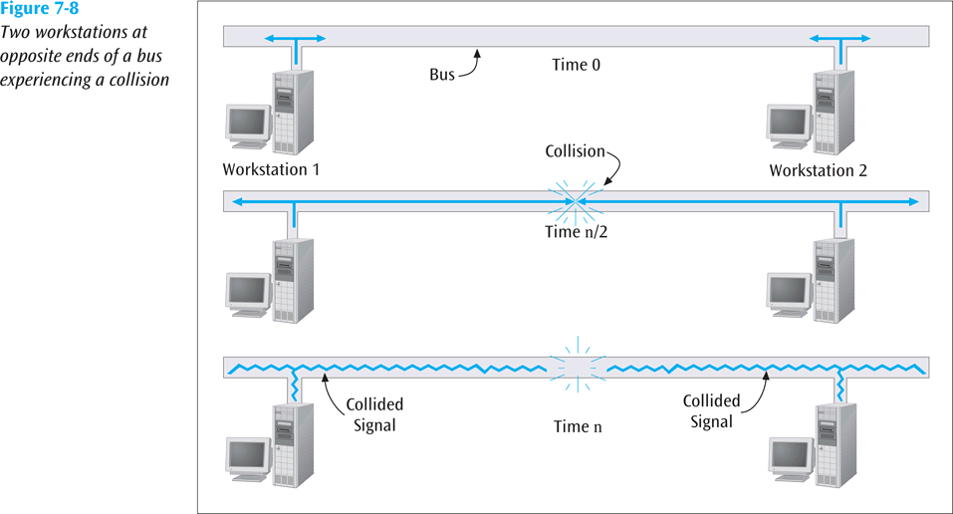
Contention-Based Protocols (continued)
Data Communications and Computer Networks: A Business User's Approach, Eighth Edition
© 2016. Cengage Learning. All Rights Reserved.

Slide 24
Switches
The hub is a simple device that transmits an incoming frame out all the other ports on the hub
The switch has intelligence and can filter out and forward frames based on their NIC address
A switch maintains internal port table(s) that keep track of which frames arrived on which ports
Switches have eliminated many hubs
Data Communications and Computer Networks: A Business User's Approach, Eighth Edition
© 2016. Cengage Learning. All Rights Reserved.

Slide 25
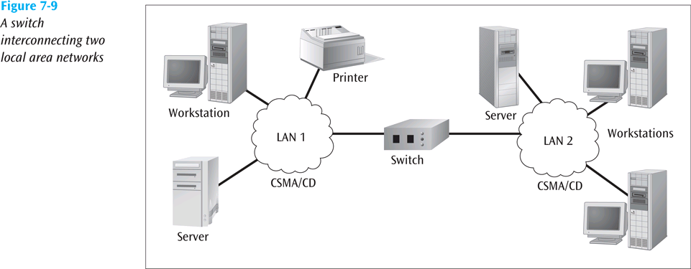
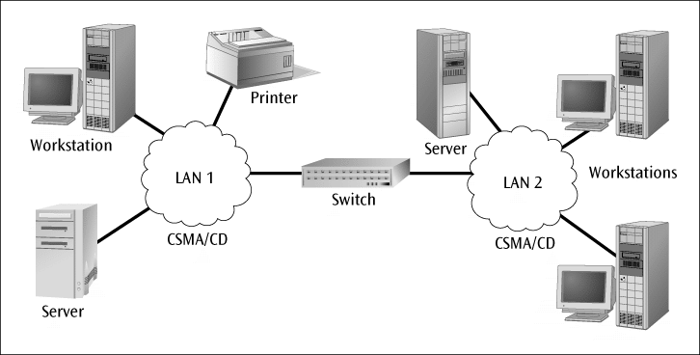
Switches (continued)
Data Communications and Computer Networks: A Business User's Approach, Eighth Edition
© 2016. Cengage Learning. All Rights Reserved.

Slide 26
Switches (continued)
A switch observes each frame that arrives at a port, extracts the source address from the frame, and places that address in the port’s routing table
A transparent switch is found with CSMA/CD LANs
Data Communications and Computer Networks: A Business User's Approach, Eighth Edition
© 2016. Cengage Learning. All Rights Reserved.

Slide 27
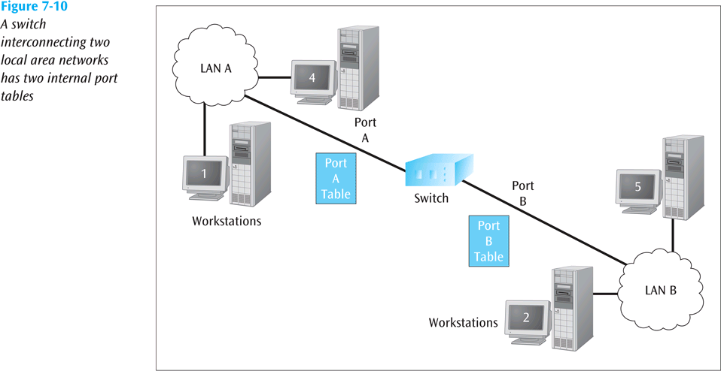
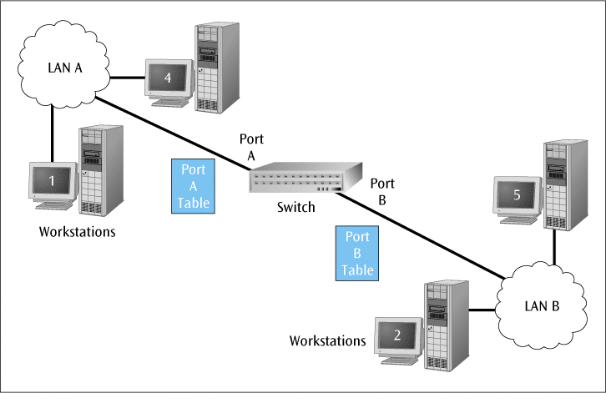
Switches (continued)
Data Communications and Computer Networks: A Business User's Approach, Eighth Edition
© 2016. Cengage Learning. All Rights Reserved.

Slide 28
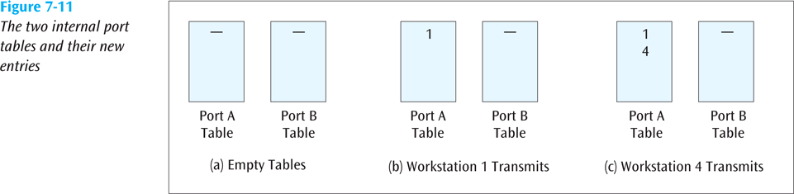
Switches (continued)
Data Communications and Computer Networks: A Business User's Approach, Eighth Edition
© 2016. Cengage Learning. All Rights Reserved.

Slide 29
Switches (continued)
Workstations that connect to a hub are on a shared segment
Workstations that connect to a switch are on a switched segment
The backplane of a switch is fast enough to support multiple data transfers at one time
Data Communications and Computer Networks: A Business User's Approach, Eighth Edition
© 2016. Cengage Learning. All Rights Reserved.

Slide 30
Switches (continued)
A switch that employs cut-through architecture is passing on frame before entire frame has arrived at switch
Multiple workstations connected to a switch use dedicated segments
  This is a very efficient way to isolate heavy users from the network
Switches can allow simultaneous access to multiple servers, or multiple simultaneous connections to a single server
Data Communications and Computer Networks: A Business User's Approach, Eighth Edition
© 2016. Cengage Learning. All Rights Reserved.

Slide 31
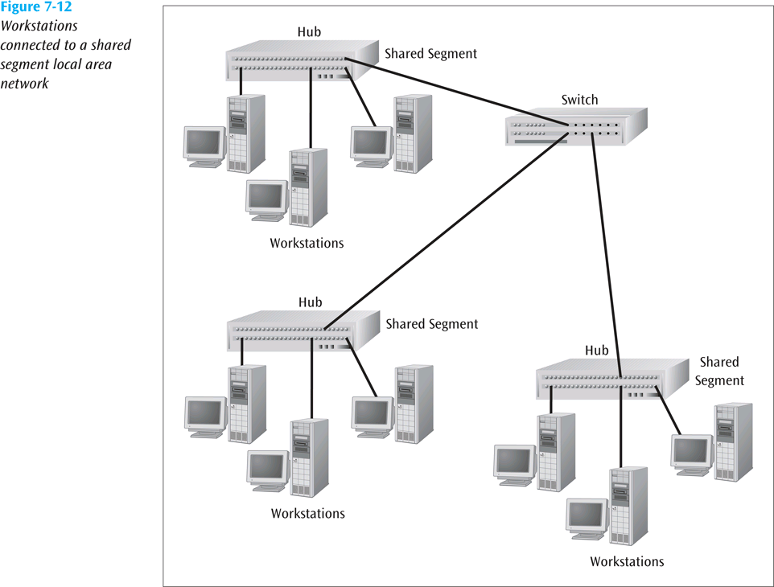
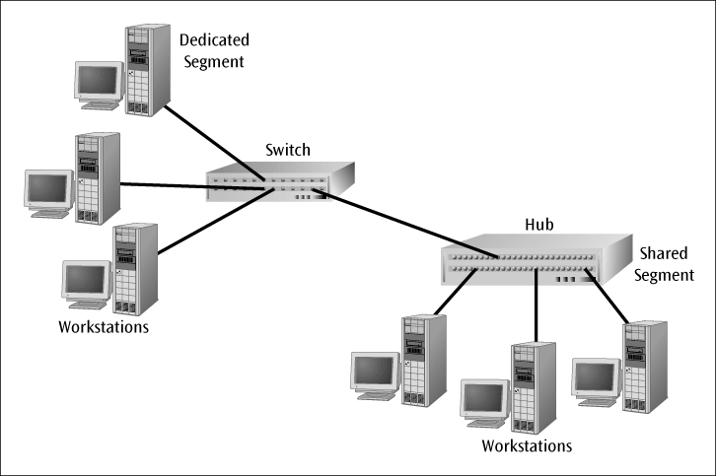
Switches (continued)
Data Communications and Computer Networks: A Business User's Approach, Eighth Edition
© 2016. Cengage Learning. All Rights Reserved.

Slide 32
Isolating Traffic Patterns and
Providing Multiple Access
Whether shared or dedicated segments are involved, the primary goal of a switch is to isolate a particular pattern of traffic from other patterns of traffic or from the remainder of the network
Switches, because of their backplane, can also allow multiple paths of communications to simultaneously occur
Data Communications and Computer Networks: A Business User's Approach, Eighth Edition
© 2016. Cengage Learning. All Rights Reserved.

Slide 33
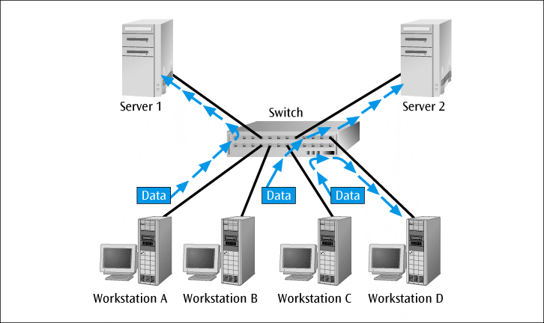
Switches (continued)
Figure 7-13
A switch with two servers allowing simultaneous access to two servers
Data Communications and Computer Networks: A Business User's Approach, Eighth Edition
© 2016. Cengage Learning. All Rights Reserved.

Slide 34
Full-Duplex Switches
Allow for simultaneous transmission and reception of data to and from a workstation
This full-duplex connection helps to eliminate collisions
To support a full-duplex connection to a switch, at least two pairs of wires are necessary
  One for the receive operation
  One for the transmit operation
  Most people install four pairs today, so wiring is not the problem
Data Communications and Computer Networks: A Business User's Approach, Eighth Edition
© 2016. Cengage Learning. All Rights Reserved.

Slide 35
Virtual LANs
Virtual LAN (VLAN) – logical subgroup within a LAN that is created via switches and software rather than by manually moving wiring from one network device to another
Even though employees and their actual computer workstations may be scattered throughout the building, LAN switches and VLAN software can be used to create a “network within a network”
Data Communications and Computer Networks: A Business User's Approach, Eighth Edition
© 2016. Cengage Learning. All Rights Reserved.

Slide 36
Virtual LANs (continued)
A relatively new standard, IEEE 802.1Q, was designed to allow multiple devices to intercommunicate and work together to create a virtual LAN
Instead of sending technician to a wiring closet to move a workstation cable from one switch to another, an 802.1Q-compliant switch can be remotely configured by a network administrator
Data Communications and Computer Networks: A Business User's Approach, Eighth Edition
© 2016. Cengage Learning. All Rights Reserved.

Slide 37
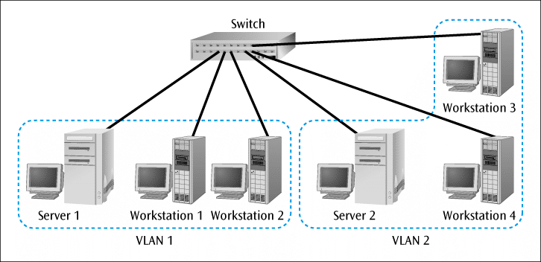
Virtual LANs (continued)
Figure 7-14
A switch with two VLANs configured
Data Communications and Computer Networks: A Business User's Approach, Eighth Edition
© 2016. Cengage Learning. All Rights Reserved.

Slide 38
Link Aggregation
Allows you to combine two or more links into one higher-speed link
Why would we want to do this?
  What if you want more bandwidth between a device and a switch?
  What if you want to provide a back-up link between a device and a switch?
  What if you want to provide a higher-speed connection to a server?
Data Communications and Computer Networks: A Business User's Approach, Eighth Edition
© 2016. Cengage Learning. All Rights Reserved.

Slide 39
Link Aggregation
An IEEE protocol (802.3ad-2000) which typically runs in most LAN devices can support link aggregation
Link aggregation attempts to balance the flow of messages over the multiple paths, unless the flow of frames belong to a particular conversation; then the frames are sent over one of the links.
Data Communications and Computer Networks: A Business User's Approach, Eighth Edition
© 2016. Cengage Learning. All Rights Reserved.

Slide 40
Spanning Tree Algorithm
What if you have a large set of networks interconnected with many switches?
Because of this large set of networks, a loop has been created in which a frame can circle through the networks and actually return to the originating device
Data Communications and Computer Networks: A Business User's Approach, Eighth Edition
© 2016. Cengage Learning. All Rights Reserved.

Slide 41
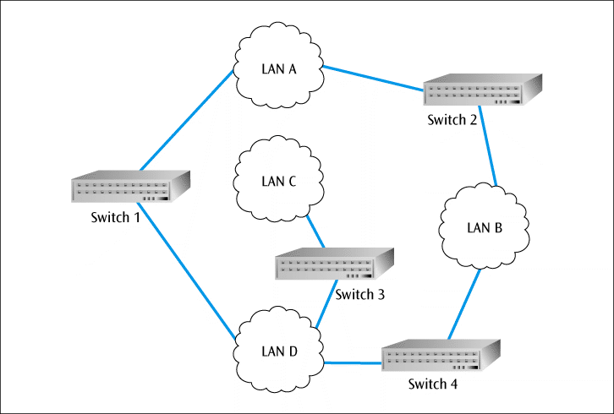
Spanning Tree Algorithm
Figure 7-15
A circular interconnection of local area networks and switches
Data Communications and Computer Networks: A Business User's Approach, Eighth Edition
© 2016. Cengage Learning. All Rights Reserved.

Slide 42
Spanning Tree Algorithm
Is this loop or circle of connections a mistake?
Not necessarily. What if the network designers wanted to create a network with two possible paths to each device (in event of a failure)?
We want to leave the physical loop in place, but want to logically remove the loop (alter the forwarding tables of the switches such that the loop no longer exists)
How do we logically remove this loop?
Data Communications and Computer Networks: A Business User's Approach, Eighth Edition
© 2016. Cengage Learning. All Rights Reserved.

Slide 43
Spanning Tree Algorithm
The spanning tree algorithm (used in Spanning Tree Protocol and now Rapid Spanning Tree Protocol) runs in switches and can identify loops and remove them
How does the spanning tree algorithm work? Four steps:
  Identify a switch as the root switch
  Visit each switch and identify the one port that has the shortest path back to the root switch. Mark these ports with RP (root port)
Data Communications and Computer Networks: A Business User's Approach, Eighth Edition
© 2016. Cengage Learning. All Rights Reserved.

Slide 44
Spanning Tree Algorithm
How does the spanning tree algorithm work? Continued:
  Visit each LAN and identify the port that provides the shortest path back to the root switch. Mark these ports with a DP (designated port).
  Are there any ports remaining that don’t have either an RP or DP designation? Mark those ports as Removed. (They aren’t physically removed, only removed in the forwarding tables)
Data Communications and Computer Networks: A Business User's Approach, Eighth Edition
© 2016. Cengage Learning. All Rights Reserved.

Slide 45
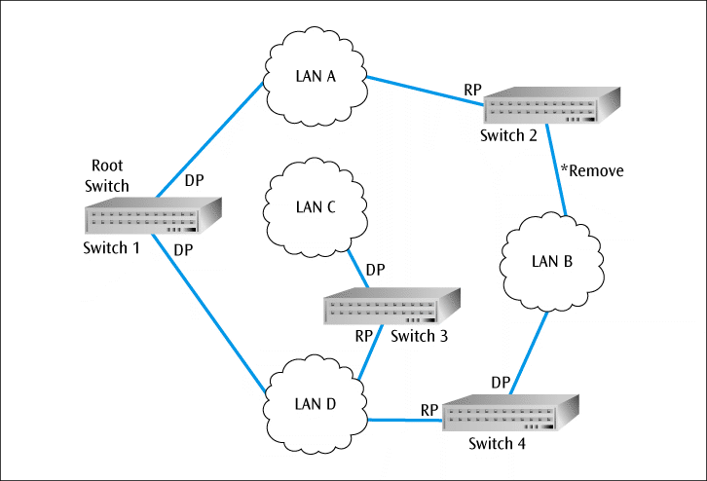
Spanning Tree Algorithm
Figure 7-16
Network interconnection indicating root switch, root ports, designated ports, and removed connections
Data Communications and Computer Networks: A Business User's Approach, Eighth Edition
© 2016. Cengage Learning. All Rights Reserved.

Slide 46
Quality of Service
On a standard Ethernet LAN, all frames have the same priority, which is none
What if you want to make video-conferencing frames a higher priority than email frames?
You can use IEEE 802.1p standard which is installed in most if not all switches
The 802.1p standard adds a 3-bit field to the front of each Ethernet frame
This 3-bit field can be used to establish a priority
Data Communications and Computer Networks: A Business User's Approach, Eighth Edition
© 2016. Cengage Learning. All Rights Reserved.

Slide 47
Quality of Service
Here are the PCP values and the associated traffic types
PCP Value Traffic Type
0 Best effort
1 Background (lowest priority)
2 Excellent effort
3 Critical applications
4 Video
5 Voice
6 Internetwork control
7 Network control (highest priority)
Data Communications and Computer Networks: A Business User's Approach, Eighth Edition
© 2016. Cengage Learning. All Rights Reserved.

Slide 48
Wired Ethernet
Most common form of LAN today
Star-wired bus is most common topology but bus topology still not totally dead yet
Comes in many forms depending upon medium used and transmission speed and technology
Data Communications and Computer Networks: A Business User's Approach, Eighth Edition
© 2016. Cengage Learning. All Rights Reserved.

Slide 49
Wired Ethernet (continued)
Originally, CSMA/CD was 10 Mbps
Then 100 Mbps was introduced
  Most NICs sold today are 10/100 Mbps
Then 1000 Mbps (1 Gbps) was introduced
10 Gbps is now being installed in high-end applications
40 Gbps (GbE) and 100 GbE are now appearing in high-end switches and networks
Data Communications and Computer Networks: A Business User's Approach, Eighth Edition
© 2016. Cengage Learning. All Rights Reserved.

Slide 50
Wired Ethernet (continued)
1000 Mbps introduced a few interesting wrinkles:
  Transmission is full-duplex (separate transmit and receive), thus no collisions
  Prioritization is possible using 802.1p protocol
    Topology can be star or mesh (for trunks)
Data Communications and Computer Networks: A Business User's Approach, Eighth Edition
© 2016. Cengage Learning. All Rights Reserved.

Slide 51
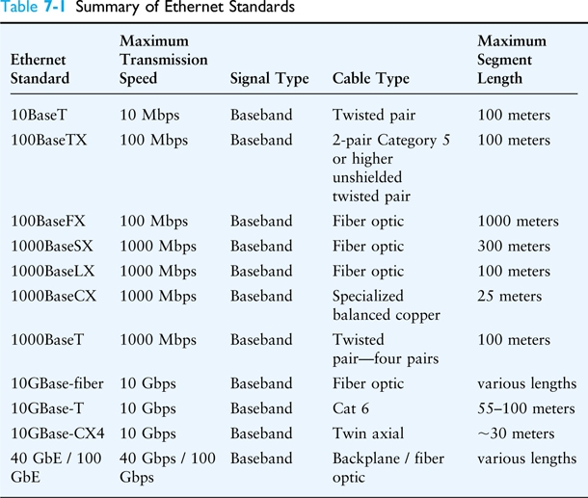
Wired Ethernet (continued)
Data Communications and Computer Networks: A Business User's Approach, Eighth Edition
© 2016. Cengage Learning. All Rights Reserved.

Slide 52
Wired Ethernet (continued)
One of the more recent features is power over Ethernet (PoE)
What if you have a remote device that has an Ethernet connection?
  It will require a power connection
What if you don’t have an electrical outlet nearby?
  Use PoE
    Power to drive Ethernet NIC is sent over wiring along with usual Ethernet signals
Data Communications and Computer Networks: A Business User's Approach, Eighth Edition
© 2016. Cengage Learning. All Rights Reserved.

Slide 53
IEEE 802
To better support local area networks, the data link layer of the OSI model was broken into two sublayers:
  Logical link control sublayer
  Medium access control sublayer
Medium access control sublayer defines frame layout and is more closely tied to a specific medium at the physical layer
  Thus, when people refer to LANs they often refer to its MAC sublayer name, such as 10BaseT
Data Communications and Computer Networks: A Business User's Approach, Eighth Edition
© 2016. Cengage Learning. All Rights Reserved.

Slide 54
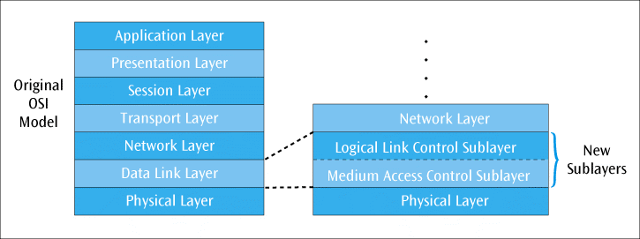
IEEE 802 (continued)
Figure 7-17
Modification of OSI model to split data link layer into two sublayers
Data Communications and Computer Networks: A Business User's Approach, Eighth Edition
© 2016. Cengage Learning. All Rights Reserved.

Slide 55
IEEE 802.3 Frame Format
IEEE 802 suite of protocols defines frame formats for CSMA/CD (IEEE 802.3) and token ring (IEEE 802.5)
Each frame format describes how data package is formed
The two frames do not have the same layout
  If a CSMA/CD network connects to a token ring network, the frames have to be converted from one to another
Data Communications and Computer Networks: A Business User's Approach, Eighth Edition
© 2016. Cengage Learning. All Rights Reserved.

Slide 56
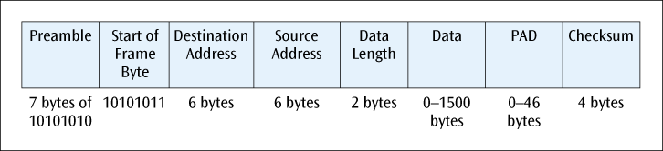
IEEE 802.3 Frame Format (continued)
Figure 7-18
Frame format for IEEE 802.3 CSMA/CD
Data Communications and Computer Networks: A Business User's Approach, Eighth Edition
© 2016. Cengage Learning. All Rights Reserved.

Slide 57
LANs In Action: A Small Office Solution
What type of system will interconnect 20 workstations in one room and 15 workstations in another room to a central server, which offers:
  Internal e-mail
  A database that contains all customer information
  High-quality printer access
Data Communications and Computer Networks: A Business User's Approach, Eighth Edition
© 2016. Cengage Learning. All Rights Reserved.

Slide 58
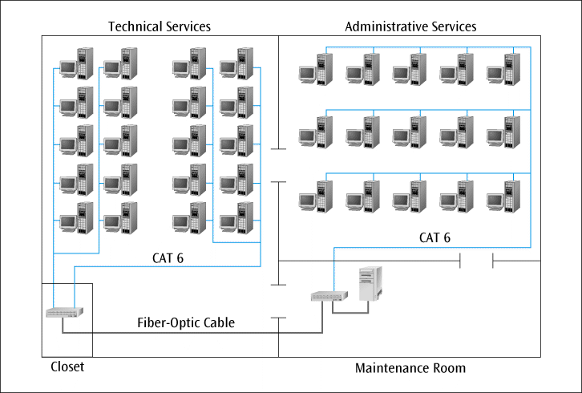
LANs In Action:
A Small Office Solution (continued)
Figure 7-19
Wiring diagram of Hannah’s office space showing the placement of switches and servers
Data Communications and Computer Networks: A Business User's Approach, Eighth Edition
© 2016. Cengage Learning. All Rights Reserved.

Slide 59
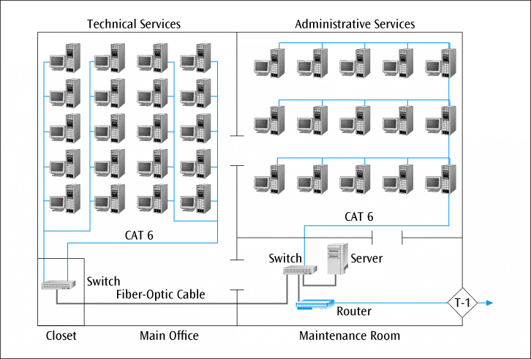
LANs In Action:
A Small Office Solution (continued)
Figure 7-20
The modified network with a router and high-speed phone line
Data Communications and Computer Networks: A Business User's Approach, Eighth Edition
© 2016. Cengage Learning. All Rights Reserved.

Slide 60
Summary
Primary functions of a LAN are to enable sharing of data, software, and peripherals and to provide common services such as file serving, print serving, support for electronic mail, and process control and monitoring in office, academic, and manufacturing environments
Local area networks have numerous advantages and disadvantages
A LAN can be configured as a bus/tree topology, a star-wired bus topology, or a wireless network
Data Communications and Computer Networks: A Business User's Approach, Eighth Edition
© 2016. Cengage Learning. All Rights Reserved.

Slide 61
Summary (continued)
With both baseband and broadband buses, expansion in the form of adding a new workstation is difficult when a tap is not available
For a workstation to place data onto a LAN, network must have a medium access control protocol
  Two basic forms of medium access control protocols are:
    Contention-based
    Round-robin
CSMA/CD works on first-come, first-served basis, supports half-duplex and full-duplex connections, and is clearly the most popular access protocol
Data Communications and Computer Networks: A Business User's Approach, Eighth Edition
© 2016. Cengage Learning. All Rights Reserved.

Slide 62
Summary (continued)
To standardize the medium access control protocols, IEEE created the 802 series of network standards
Virtual LANs allow network administrators to create subgroups of devices on a LAN
The IEEE 802.1q standard supports virtual LANs
Data Communications and Computer Networks: A Business User's Approach, Eighth Edition
© 2016. Cengage Learning. All Rights Reserved.

Slide 63
Summary (continued)
Link aggregation allows one to combine two or more data paths or links into one higher-speed link
Link aggregation is supported by the IEEE 802.3ad-2000 standard
The Spanning Tree Algorithm can be used to eliminate cycles within larger local area network installations
The Rapid Spanning Tree Protocol incorporates the Spanning Tree Algorithm
Data Communications and Computer Networks: A Business User's Approach, Eighth Edition
© 2016. Cengage Learning. All Rights Reserved.

Slide 64
Summary (continued)
Many forms of wired Ethernet exist, including twisted pair and fiber optic versions, from 10 Mbps up to 100 Gbps
The basic Ethernet frame consists of an 8-byte header, two 6-byte NIC addresses, a length or type field, a data field, an optional pad field, and a 4-byte checksum
Data Communications and Computer Networks: A Business User's Approach, Eighth Edition
© 2016. Cengage Learning. All Rights Reserved.

